Slide 1
Freedom of Expression on Social Media in Georgia – Case for the Urgent Need of Online Regulation
Dr. Sergi Jorbenadze
01.10.2021

Slide 2
Using of Social Media in Georgia
1
Freedom of Expression in Georgia
2
Social Media Law Cases in the Court
3
Georgia: Pilot Country
4

Slide 3
Using of Social Media in Georgia
1
Freedom of Expression in Georgia
2
Social Media Law Cases in the Court
3
Georgia: Pilot Country
4

Slide 4
Big Players
Politicians
Church
Business

Slide 5
Elections in Georgia
Free Political Advertisement
Is not according to Georgian Legislation

Slide 6
Using of Social Media in Georgia
1
Freedom of Expression in Georgia
2
Social Media Law Cases in the Court
3
Georgia: Pilot Country
4

Slide 7
Several Regulations
Almost Unlimited Freedom
Write everything what somebody wants?
No Censure

Slide 8
Using of Social Media in Georgia
1
Freedom of Expression in Georgia
2
Social Media Law Cases in the Court
3
Georgia: Pilot Country
4

Slide 9
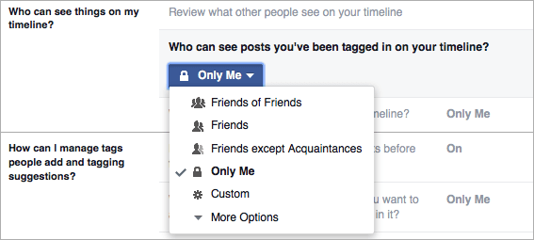
Provisional Measure
Switch to
Till the end of Hearing
Facebook Post
Public

Slide 10
Delete a Group on Facebook
Bulling
Goals of the Group
Joke
Using a Nickname
Violation of the Non-property Right
Difficulty of Identification

Slide 11
Hate Speech on YouTube and Facebook
Claim
Not Restricting the audience of the Facebook post and YouTube video in question to ensure that its dissemination is restricted
Not Deactivating account or partially deactivating account spreading fake content
Not Deleting Facebook friends and more than 30% of YouTube subscribers so that less users have access to the video

Slide 12
Petty Hooliganism
Is Facebook the Public Place?
Is the Closed Group the Public Place?
What is the Difference between Petty Hooliganism and Freedom of Expression?

Slide 13
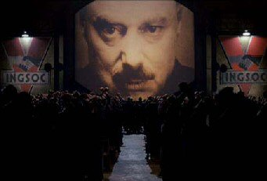
When “Big Brother” creates an Account on YouTube…
…and the State can not find the publisher

Slide 14
Using of Social Media in Georgia
1
Freedom of Expression in Georgia
2
Social Media Law Cases in the Court
3
Georgia: Pilot Country
4

Slide 15
The using of Social Media is high (High usage of Facebook)
There is risk of violation of follow issues:
Freedom of Expression / Disinformation
Right of honor
Right of name
Right of private life
Copyright
Criminal cases

Slide 16
Who needs to have council for social media law disputes?
Government
Politicians
Private sector (business)
Education sector
NGO-sector
International organizations
Church (The Patriarchate)
Citizen of Georgia

Slide 17
Using Legislation
International Rules
International Principles
Georgian Legislation

Slide 18
Georgia as an example Country
Something not working properly? Georgia can solve this case.
Georgia’s experience can be transferred in other countries.
Georgia will develop social media law that can be used in other countries as well.
Georgia offers excellent opportunities for field experiments.

Slide 19
Thank you!
sergi.Jorbenadze@tsu.ge

